Slide 1


Humanoid robots - Does that mean artificial intelligence?
M.Eng. Janine Breßler
Technische Hochschule Wildau - Telematik
janine.bressler@th-wildau.de
49th ADBU Congress, Bordeaux 2019

Slide 2

… is where the Berlin television tower points.
https://www.byteforest.de
Humanoid robots - Does that mean artificial intelligence? | 49th ADBU Congress | September 2019 | Janine Breßler |

Slide 3

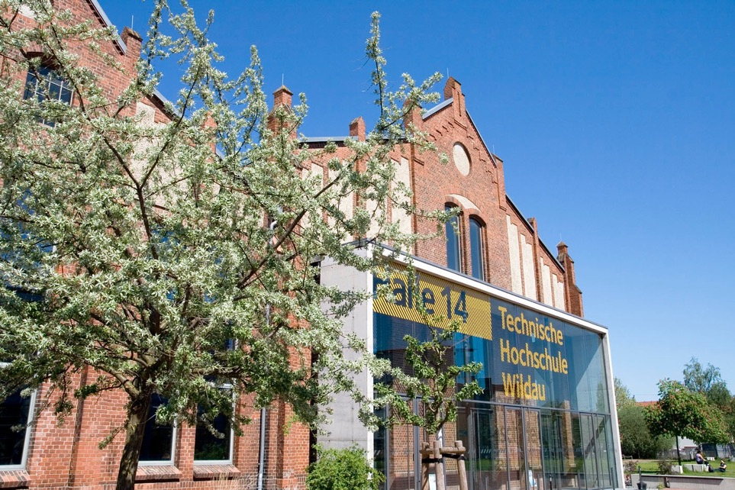

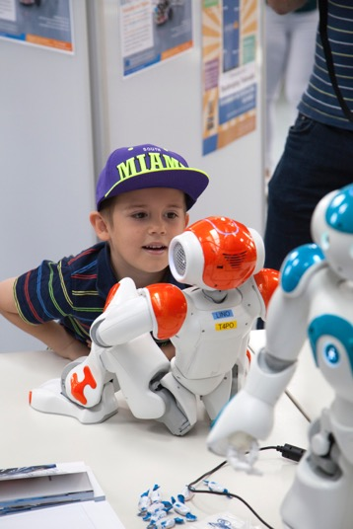

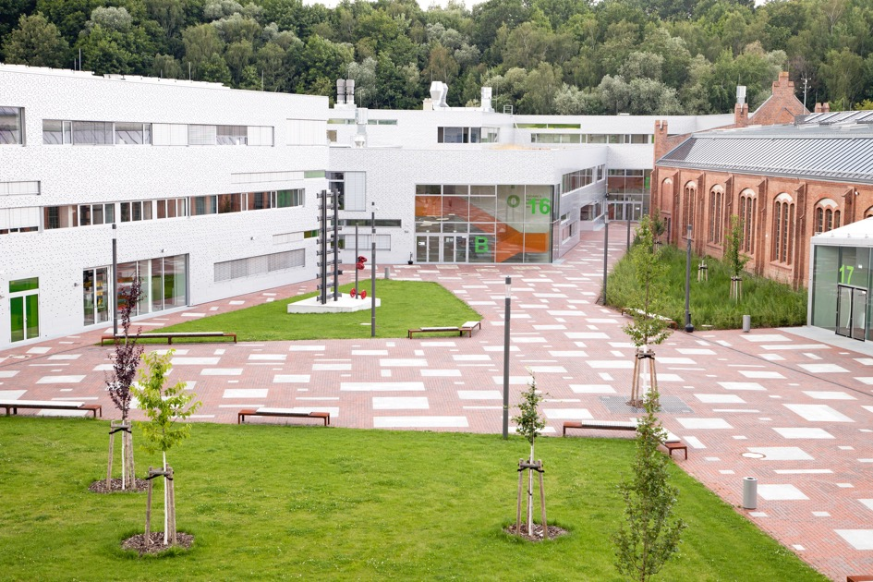
Impressions of the Campus …
Humanoid robots - Does that mean artificial intelligence? | 49th ADBU Congress | September 2019 | Janine Breßler |
Notes:
Campus university on which once locomotives were manufactured
Today: combination of tradition and the new
20% international students
TH Wildau - founded 1991
rather small 4000 students
— strong in research
— TUAS ==> many cooperations with the economy
KLICK->

Slide 4
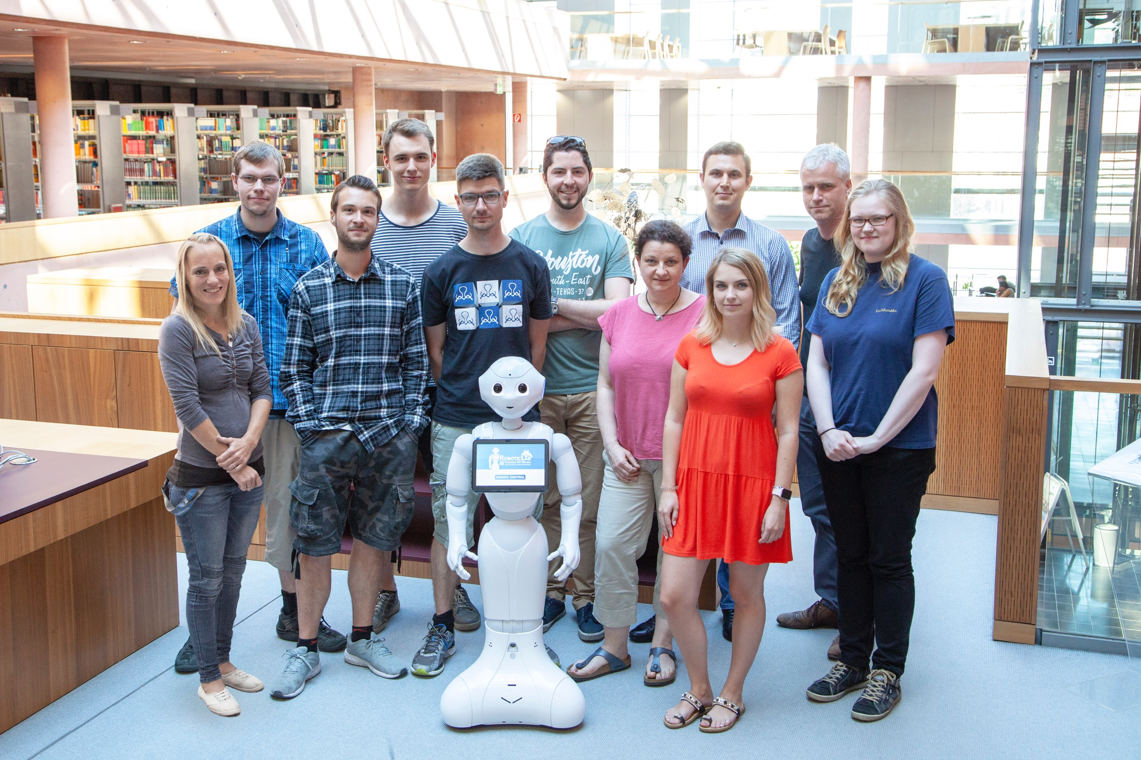
RoboticLab-Team Telematics as the Cooperation Partner with the University Library and Pepper
Humanoid robots - Does that mean artificial intelligence? | 49th ADBU Congress | September 2019 | Janine Breßler |

Slide 5

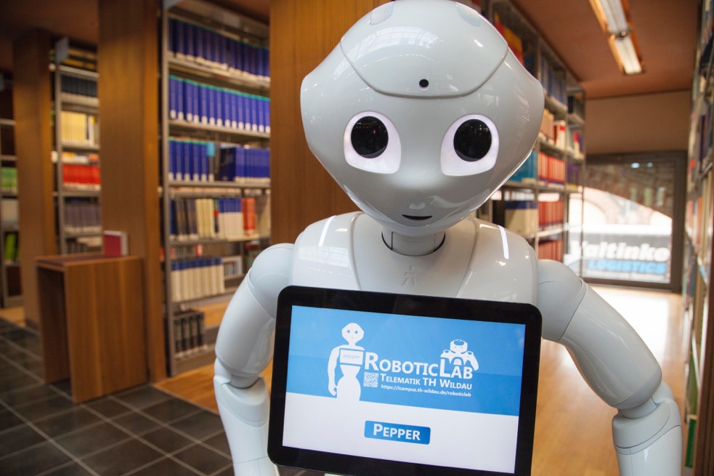
A Look into the Library of the TUAS Wildau
… with Pepper as mobile advertising pillar
Humanoid robots - Does that mean artificial intelligence? | 49th ADBU Congress | September 2019 | Janine Breßler |
Notes:
A look at the library of the university and a few facts:
5.7 employees, one of them a computer scientist
about 134.00 media (printed and electronic)
Since September 2016 : 2 of these Pepper robots (Wilma Library, Bernd RoboticLab) from the French/Japanese company Softbanks Robotics
Profile Pepper:
designed as a sympathetic and cooperative robotic companion
available in Europe since September 2016
about. 1.20 m tall, mobile on castors, movable in three axes
Objective: Use in the university library in Wildau as an autonomously acting mobile advertising pillar….
*KLICK

Slide 6
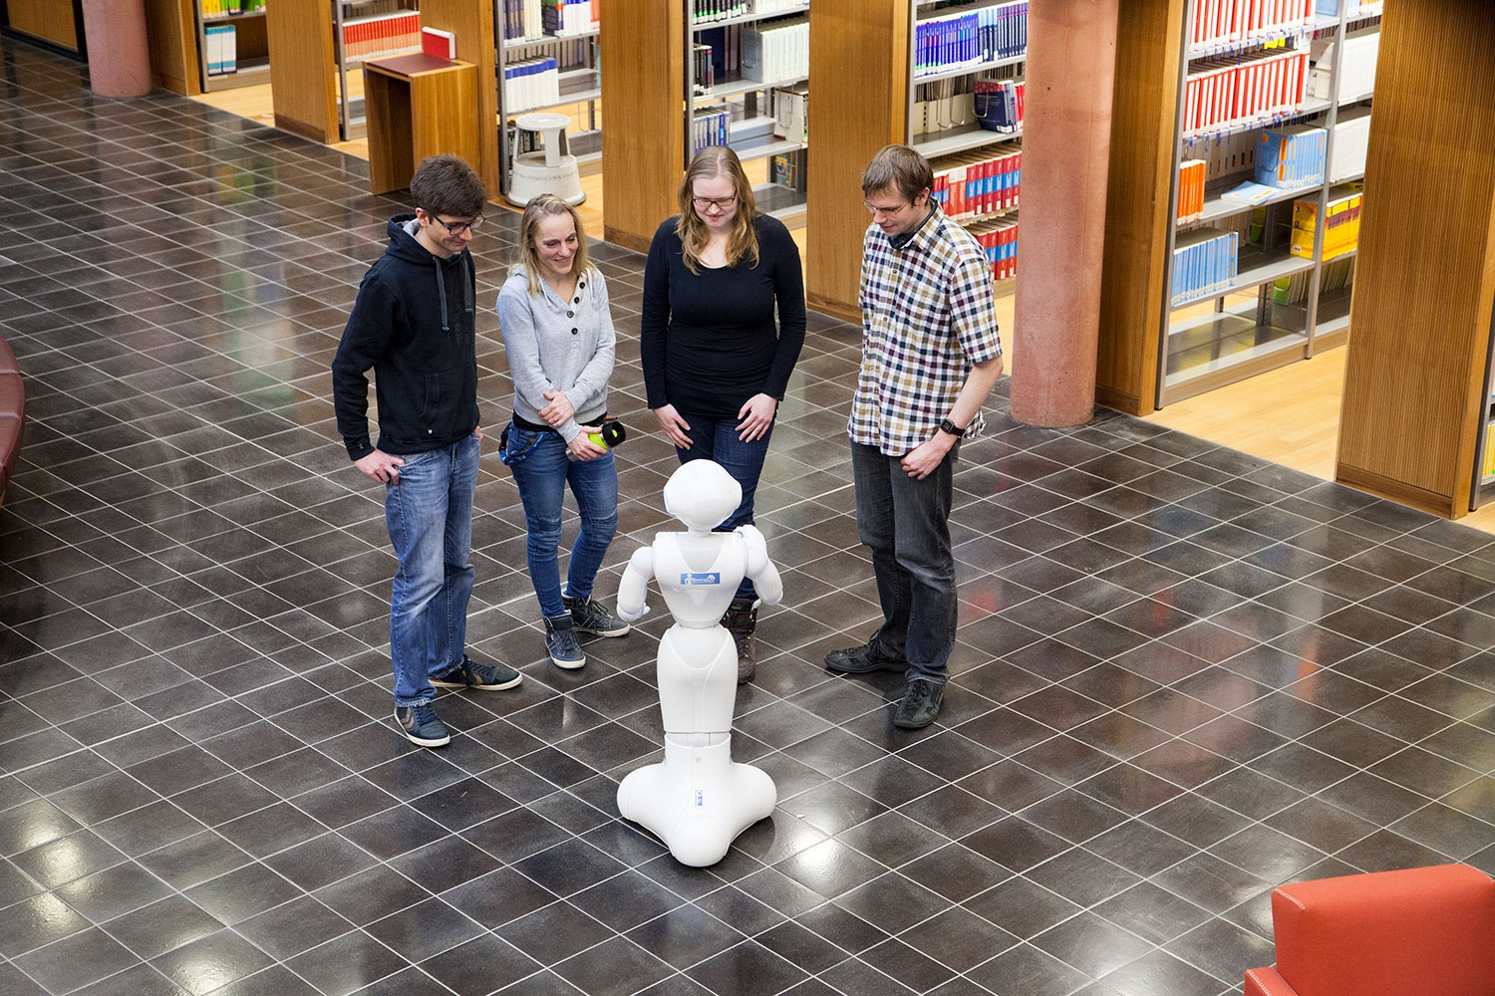
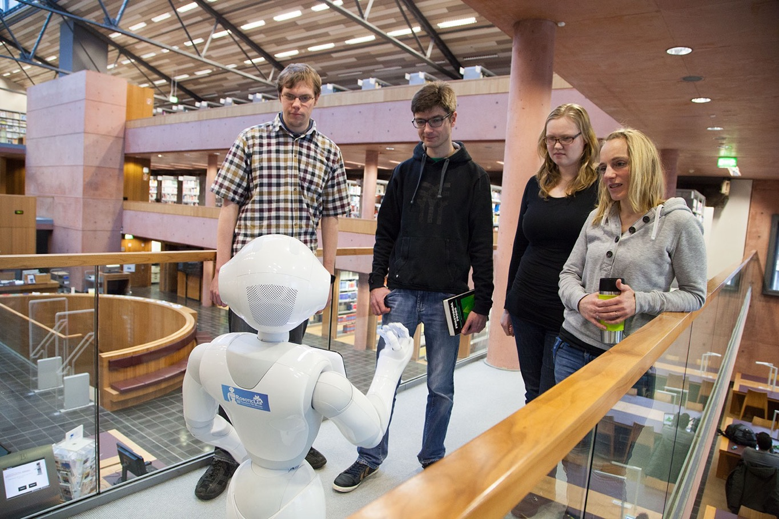
Pepper as a mobile Advertising Column: Our Vision
Explained by example:
“It's September. The lecture time at the TUAS Wildau has just started again. In the library it is very crowded and all employees at the reception have a lot to do.
Four new students at the TUAS are about to leave again in order to have the most important offers of their library explained to them later, when they notice Pepper in the entrance area. They approach curiously but carefully ...”
Thanks to Philipp Müller, master student of telematics, employee at RoboticLab, for this presentation.
Humanoid robots - Does that mean artificial intelligence? | 49th ADBU Congress | September 2019 | Janine Breßler |
Notes:
Our Vision explained by example:
… and then Pepper already starts speaking to them …
How can I help you …

Slide 7
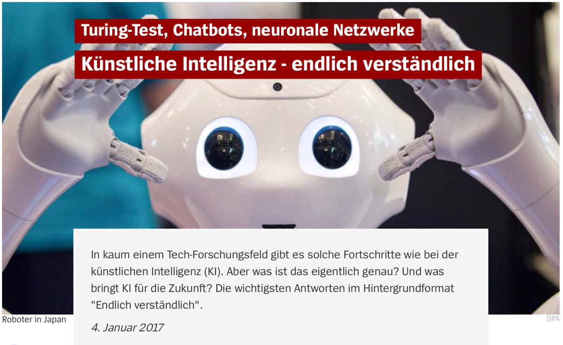
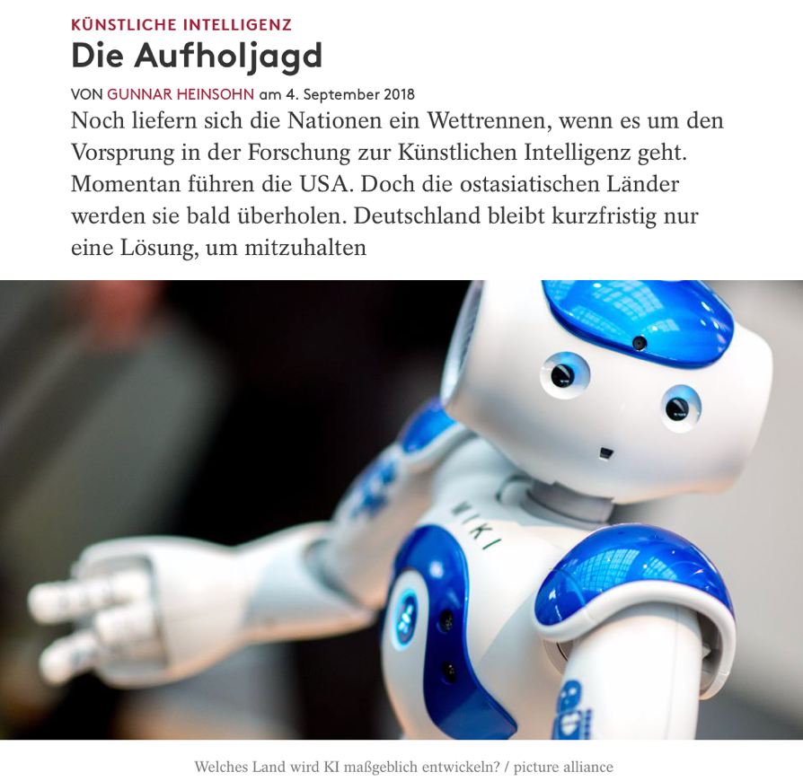
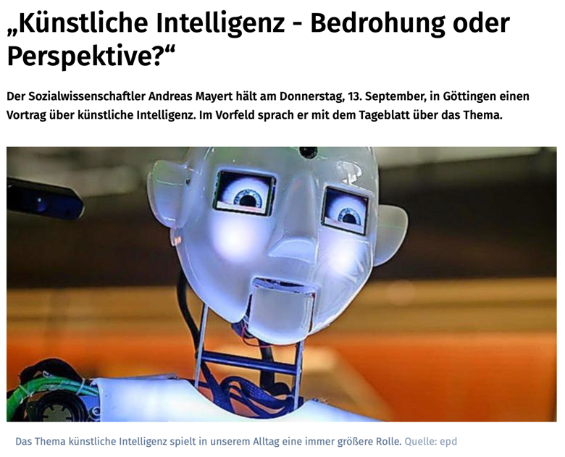
Source: https://www.spiegel.de/netzwelt/gadgets/kuenstliche-intelligenz-turing-test-chatbots-neuronale-netzwerke-a-1126718.html
Source: https://www.cicero.de/wirtschaft/kuenstliche-intelligenz-aufholjagd-international-wettrennen-deutschland-frankreich
Source: https://www.goettinger-tageblatt.de/Campus/Goettingen/Kuenstliche-Intelligenz-Bedrohung-oder-Perspektive
Do you notice anything?
Humanoid Robots == Artificial Intelligence?
Humanoid robots - Does that mean artificial intelligence? | 49th ADBU Congress | September 2019 | Janine Breßler |
Notes:
Before going into more detail about our vision and the current status, I would like to go into the initial question and topic of this lecture.
if you type Artificial Intelligence into a well known search engine, you will get these results …
So one might think that humanoid robots can be equated with artificial intelligence.
Aus: Spiegel Online
Aus: Cicero - Magazin für politische Kultur
Aus: Göttinger Tagesblatt

Slide 8
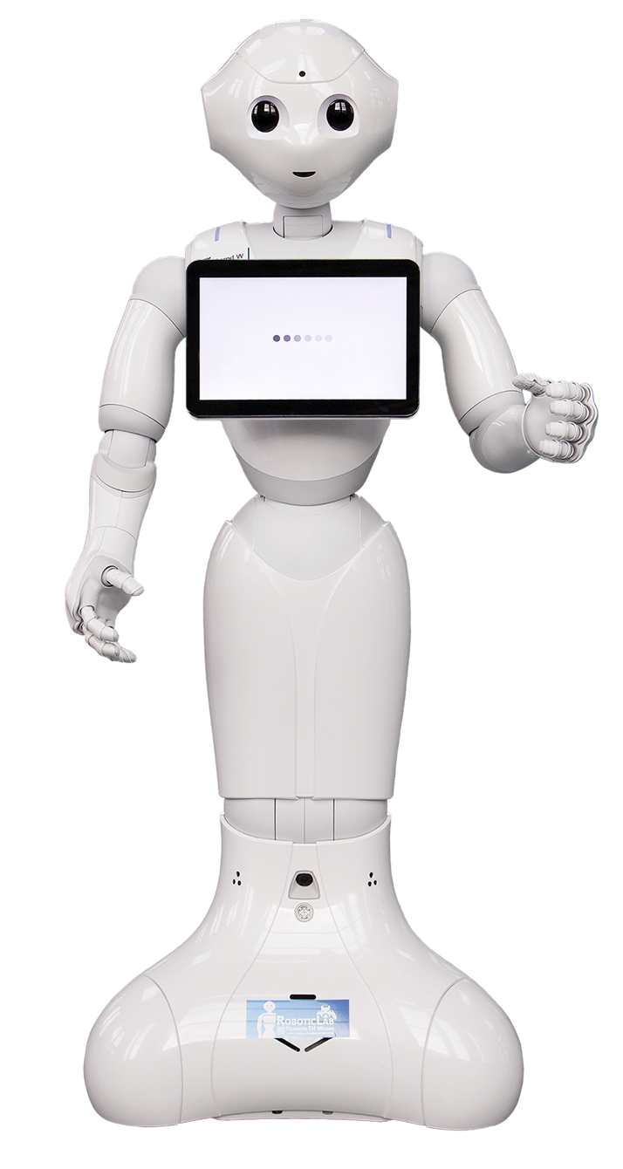
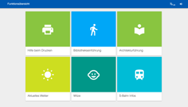
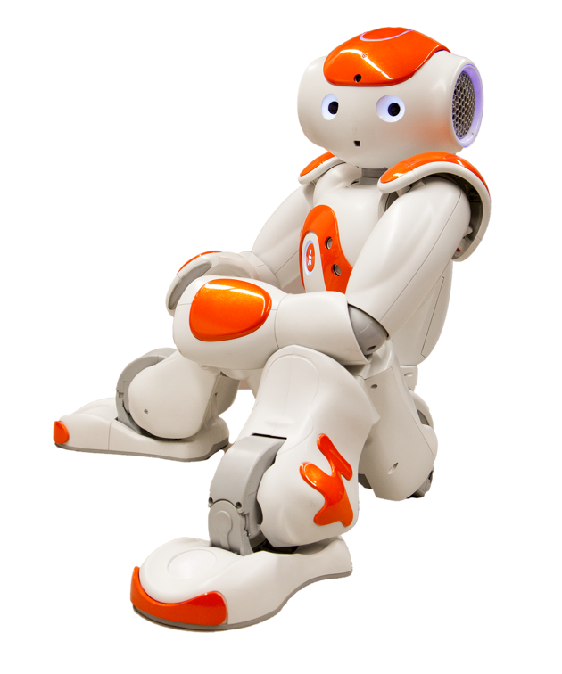
Pepper and NAO are embedded Systems:
Power On/Off
Only Software allows them to complete Tasks.
Humanoid robots - Does that mean artificial intelligence? | 49th ADBU Congress | September 2019 | Janine Breßler |
Notes:
Just a reminder:
-> humanoid robots = AI, in our opinion no -> because only machine with a lot of sensors and actuators in a nice human-like shell
-> if you unpack Pepper, he's stupid, he can't do anything
-> you have to write applications that let Pepper do what our Pepper does in the library

Slide 9

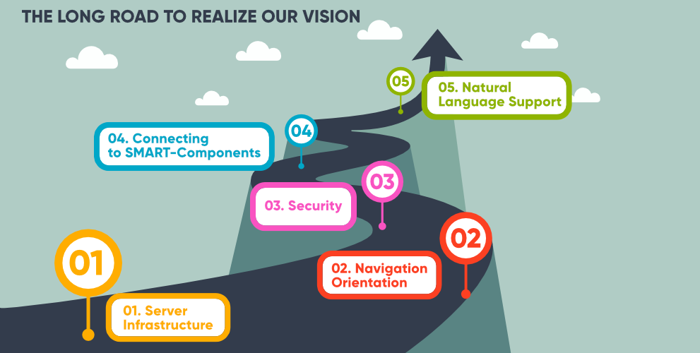
AI -> Machine Learning
Source: B. Stahl using freepiks https://de.freepik.com/vektoren-kostenlos/unternehmen-meilensteine-mit-kreisen-und-pfeil_1296164.htm
Humanoid robots - Does that mean artificial intelligence? | 49th ADBU Congress | September 2019 | Janine Breßler |
Notes:
- All these applications that we installed and developed on and for Pepper in the library can be seen on, what we like to call, the long road to our vision.
*Klick
- And the little piece of software that really contains AI is number 5, the Natural Language Support. It actually uses machine learning, the supreme discipline of AI.

Slide 10
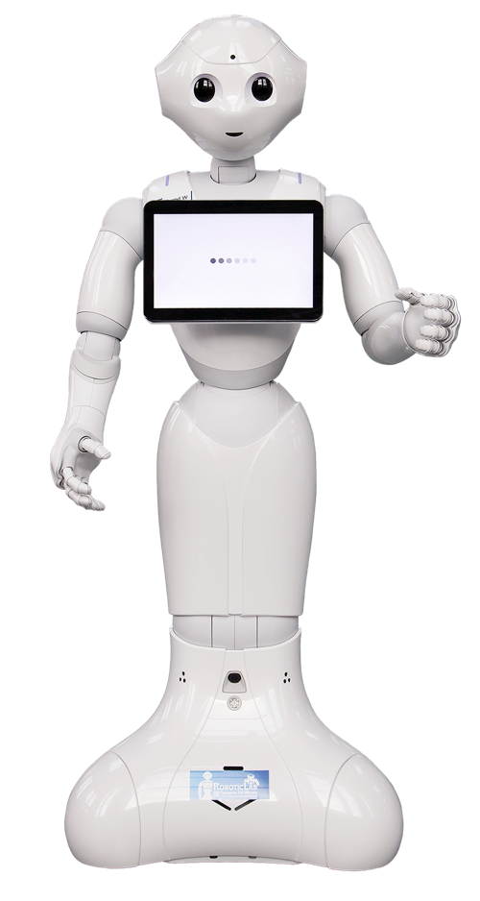

Interaction with the User: Tablet or Language?
Natural Language Processing - The Challenge
„Where can I …“
…
Listen
Convert
Analyze
Respond
Machine Learning (AI)
Humanoid robots - Does that mean artificial intelligence? | 49th ADBU Congress | September 2019 | Janine Breßler |
Respond

Slide 11
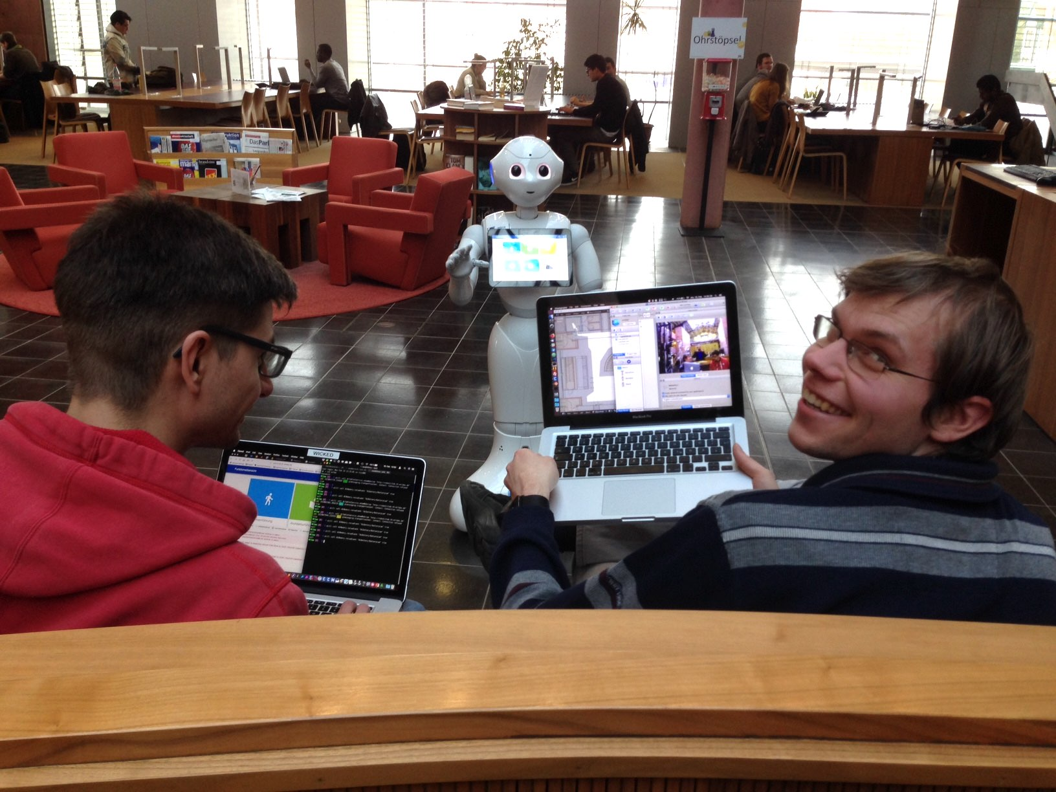
How the RoboticLab Team and the Library Team work together
Humanoid robots - Does that mean artificial intelligence? | 49th ADBU Congress | September 2019 | Janine Breßler |
Notes:
Bernd is for development, he is with the research team
the second robot named Wilma is active in the library
This allows additional functions to be developed in parallel by the developers
whenever a function is finished and tested, it is transferred to Wilma in the library.
no downtime due to new developments.
Here: two developers from the RoboticLab who are transferring a new feature to Wilma.
exchange between the library team and the RoboticLab team is very important in order to gain acceptance among the library staff
employees of the library can call the RoboticLab at any time if there are problems and it is quickly helped

Slide 12


User benefits?
Humanoid robots - Does that mean artificial intelligence? | 49th ADBU Congress | September 2019 | Janine Breßler |
Notes:
user benefits
Where's the coldest and quietest place in the library?
Help with printing
Jokes (very popular during the examination period)
Playing a game of Tic Tac Toe against the Pepper
ask the most frequently asked questions to Pepper in naturally spoken language and of course get an answer as well
library introduction
Ranking:
24/7
Witze
Bibliothekseinführung

Slide 13
Humanoid robots - Does that mean artificial intelligence?
M.Eng. Janine Breßler
Technische Hochschule Wildau - Telematik
janine.bressler@th-wildau.de
49th ADBU Congress, Bordeaux 2019
Notes:
Attention

