Slide 1
TEXT AND DATA MINING IN PUBLIC RESEARCH
Rob Johnson – 13/12/2016

Slide 2
1. Why does TDM matter?
2. Why isn’t it used more widely in public research?
3. How do we change this?

Slide 3
Study aims
Assess economic impact of TDM on public research in France via:
Case studies (France, UK, Europe)
Analysis of the relevance of a copyright exception for TDM
http://adbu.fr/etude-tdm/

Slide 4
€16 billion
Value of R&D performed within French universities and public research bodies (source: Eurostat)
6-fold return
€6 contribution to EU economy for each €1 directly generated by research universities (source: Biggar Economics)
20% per annum
Estimated rate of return to public investment in science and innovation (source: Frontier Economics)
Notes:
France - €6.4billion R&D in government sector, €10 billion in HE
UK - €3billion in government, €9 billion

Slide 5
2.5 quintillion bytes
Data produced each day
2.4 million
Scientific articles per annum
Zero
Number of researchers who can keep up

Slide 6
What is TDM?
Any automated analytical technique aiming to analyse text and data in digital form in order to generate information such as patterns, trends and correlations.
European Commission. Proposal for a Directive of the European Parliament and of the Council on copyright in the Digital Single Market
Notes:
A number of studies indicate that TDM can increase the efficiency of research
Increase coverage of literature reviews
Cut down manual work
Automate information retrieval
Accelerate drug discovery

Slide 7
BASE CAMP
Where are we now, and how did we get here?

Slide 8
What is the problem?
…countries, in which academic researchers must acquire the express consent of rights holders to conduct lawful datamining, exhibit a significantly lower share of data mining research output relative to total research output
Handke, Guilbault and Vallbe IS EUROPE FALLING BEHIND IN DATA MINING? (2015)

Slide 9
What is the result?
The European ecosystem for engaging in text and data mining remains highly problematic… The end result: Europe is being leapfrogged by rising interest in other regions, notably Asia.
Filippov, S. & Hofheinz, P. Text and Data Mining for Research and Innovation (2016)

Slide 10
Legislative options
Loi pour une République Numérique (Loi LEMAIRE)
28 September 2016
2017?
2014
1.5?
1 2 3 4
Industry self-regulation
Commercial research, beneficiaries restricted
Commercial research purpose, beneficiaries unrestricted
Non-commercial research only
Mandatory exceptions to copyright

Slide 11
Using a TDM exception
Restriction | France
No lawful access
Not scientific literature |  | -
Not public research
Commercial purpose
Conservation not by designated body
Notes:
Note - Conservation requirements could be a positive in terms of reproducibility

Slide 12
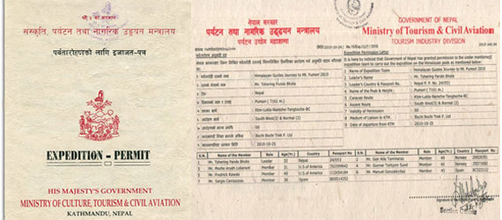
1. ACHIEVING LEGAL CLARITY

Slide 13
Summit: Researchers embrace TDM
Camp 4: Skills and support
Camp 3: Technical infrastructure
Camp 2: Access to content
Camp 1: Legal clarity
EC Directive
Copyright exception
(Base Camp)

Slide 14
The exception has made a massive difference...
Petr Knoth, Open University, UK

Slide 15
…the definition of commercial and non-commercial research is creating uncertainty
Petr Knoth, Open University, UK

Slide 16
EC Proposed Directive
Consistent with the existing EU copyright legal framework
Could help resolve uncertainty over commercial partnerships
Currently out for consultation
Source: http://www.comodinicachia.com/timeline.html

Slide 17
What needs to happen?
Communicate legal provisions for TDM with certainty and clarity
Clarify the exception’s scope where public researchers collaborate with commercial partners
Monitor the interaction of the copyright exception with digital rights management (DRM), licensing and other relevant legal regimes

Slide 18
Any questions?

Slide 19
2. SECURING ACCESS

Slide 20
I scaled down my TDM research, and had to exclude two publishers… I couldn’t do what I set out to do
Chris Hartgerink, Tilburg University, Netherlands

Slide 21
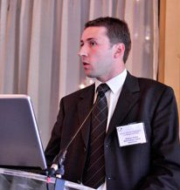
I had to ask too many publishers for the right to download … it takes a lot of time and … the publishers’ servers frequently block us.
Mathieu Andro, INRA, France

Slide 22
What is the problem with access?
Technical protection measures (TPMs)
Crawler traps
Restricted access to application programming interfaces (APIs)
Notes:
A many-to-many problem

Slide 23
What needs to happen?
Incorporate TDM clauses into model licence agreements
Educate researchers on their rights
Maintain dialogue with publishers
Improve access through better infrastructure…

Slide 24
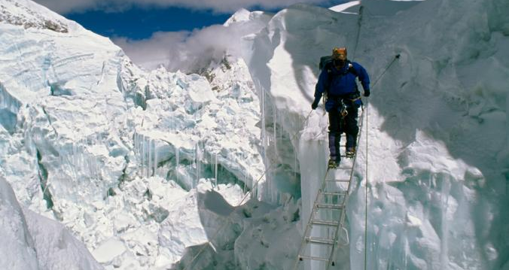
3. INFRASTRUCTURE & TOOLS
Image: National Geographic

Slide 25
…Every time you have a new project or data source… you hit issues about how the documents are structured, oddities of formatting, and so on.
Mark Greenwood, GATE, UK

Slide 26
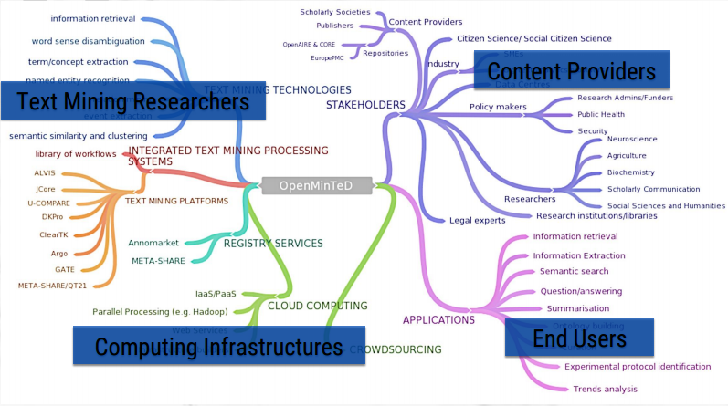
The TDM Landscape
Source: OpenMinTED

Slide 27
What needs to happen?
Invest in TDM infrastructure
Make TDM accessible to non-specialists
Streamline access
Open standards and harmonised data formats

Slide 28
4. SKILLS & SUPPORT

Slide 29
…We have algorithms to answer questions, but we do not have algorithms to ask questions
François Rioult, GREYC Laboratory, Université de Caen, France
François Rioult

Slide 30
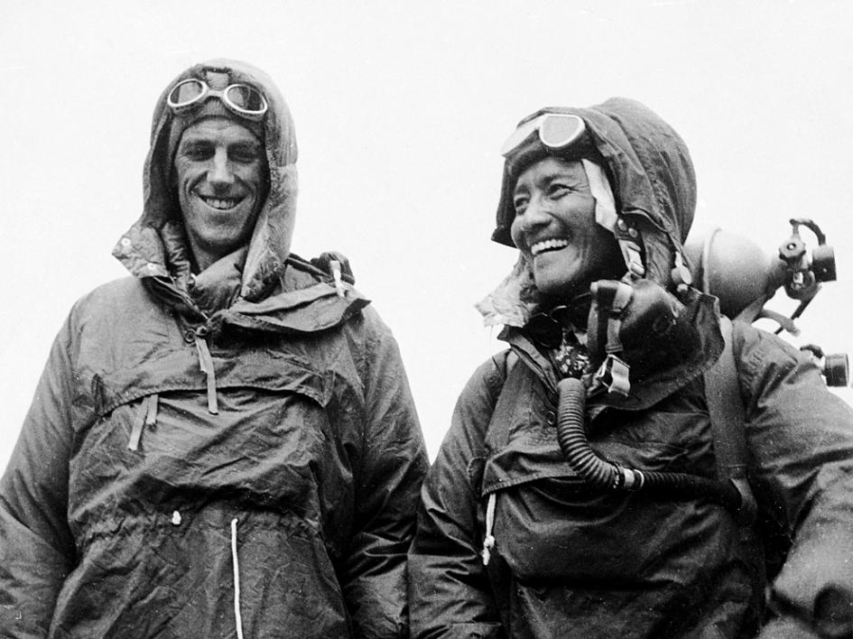
What is the role of the librarian?
Photo: REUTERS
Notes:
Edmund Hillary and Tenzing Norgay

Slide 31
The library needs to be able to say: ‘If you’ve got a question about TDM, come to us’
Danny Kingsley, Head of Scholarly Communications, University of Cambridge, UK

Slide 32
Library support for TDM
Advocacy
Copyright advice
Access to legal expertise
Skills development and training
Advice on data sources and tools
Notes:
Advocacy for the benefits of TDM at all levels of the organisation
Copyright advice on using the TDM exception
Access to legal expertise
Skills development (indexing and metadata curation) and access to technical training (coding and high performance computing)
Advice on data sources and tools

Slide 33
5. EMBRACING TDM

Slide 35
Why?
"Because it's there"

Slide 36
There are so many obstructions in the way of doing this research, and doing it well. It is just too hard and so people do other things
Ross Mounce, University of Cambridge, UK

Slide 37
What needs to happen?
Endorsement by senior research leaders
Funding and incentives linked to TDM
Alignment with moves to open science

Slide 38
1. Why does TDM matter?
2. Why isn’t it used more widely in public research?
3. How do we change this?

Slide 39
Why does TDM matter?
Public research is valuable
TDM makes research more efficient
TDM is worth investing in

Slide 40
1. Why does TDM matter?
2. Why isn’t it used more widely in public research?
3. How do we change this?

Slide 41
Summit: Researchers embrace TDM
Camp 4: Skills and support
Camp 3: Technical infrastructure
Camp 2: Access to content
Camp 1: Legal clarity
EC Directive
Copyright exception
(Base Camp)

Slide 42
1. Why does TDM matter?
2. Why isn’t it used more widely in public research?
3. How do we change this?

Slide 43
Making TDM a reality
Libraries
Monitor researchers’ experience
Develop case studies and guidance
Involve the national library
Invest in TDM support
Incorporate TDM clauses into licence agreements
researchers’ experiences

Slide 44
Making TDM a reality
Legislators
Provide certainty
Enable public/private partnerships
Monitor interaction with other legislation (e.g. DRM)
Institutions/research leaders
Endorse TDM
Invest in library services
Explore knowledge exchange opportunities
Research funders
Invest in infrastructure
Forum to improve access
Link TDM to Open Science
Publishers & providers
Cloud services for TDM
Steamline access
Open, harmonised standards

Slide 45
Thank you
Rob Johnson
Full report available at::
http://adbu.fr/etude-tdm/
rob.johnson@research-consulting.com
www.research-consulting.com
Template inspired by SlidesCarnival

